Slide 1
Internal Mass Migration
The westward movement of people after the Civil War
(Why do people migrate?)

Slide 2
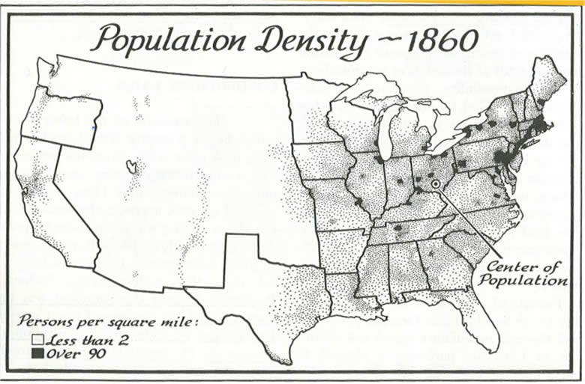

Slide 3
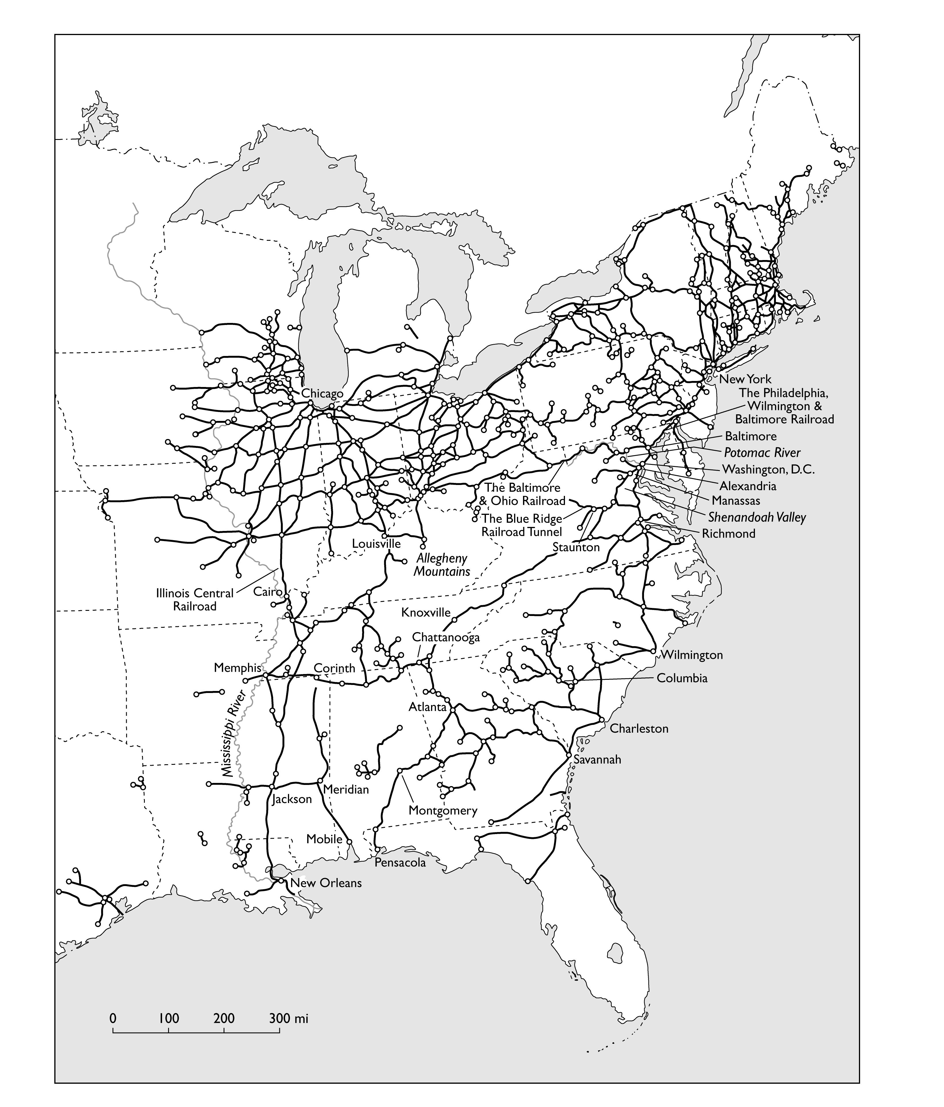
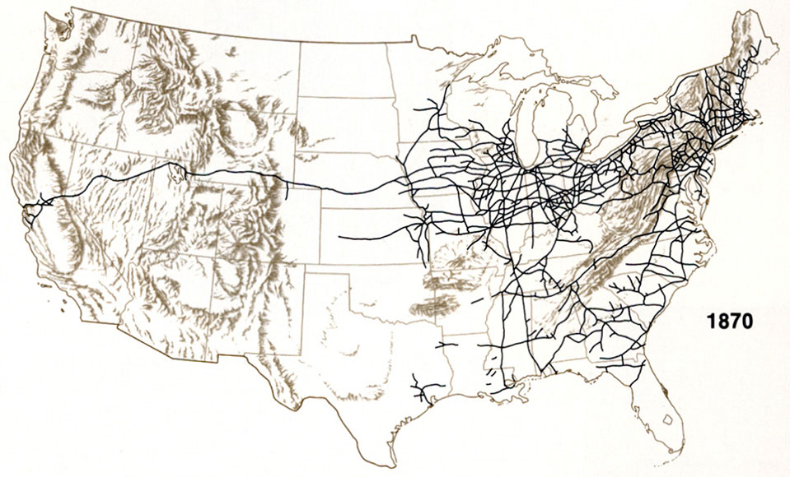
Railroads, 1861

Slide 4
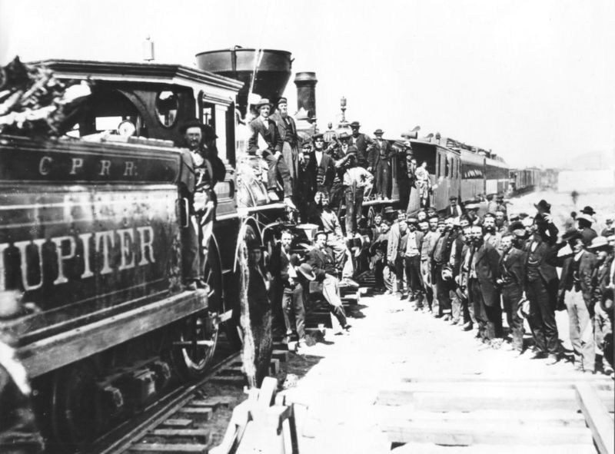

Slide 5
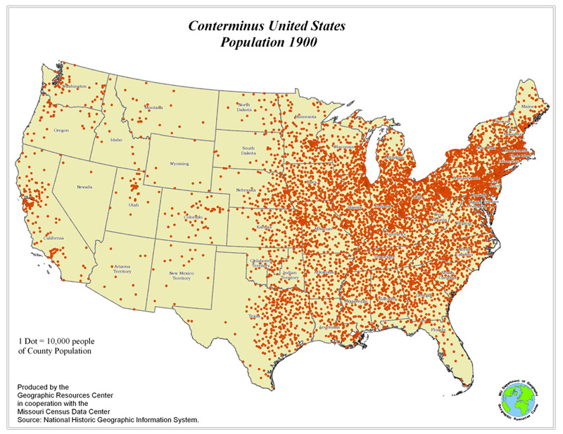

Slide 6
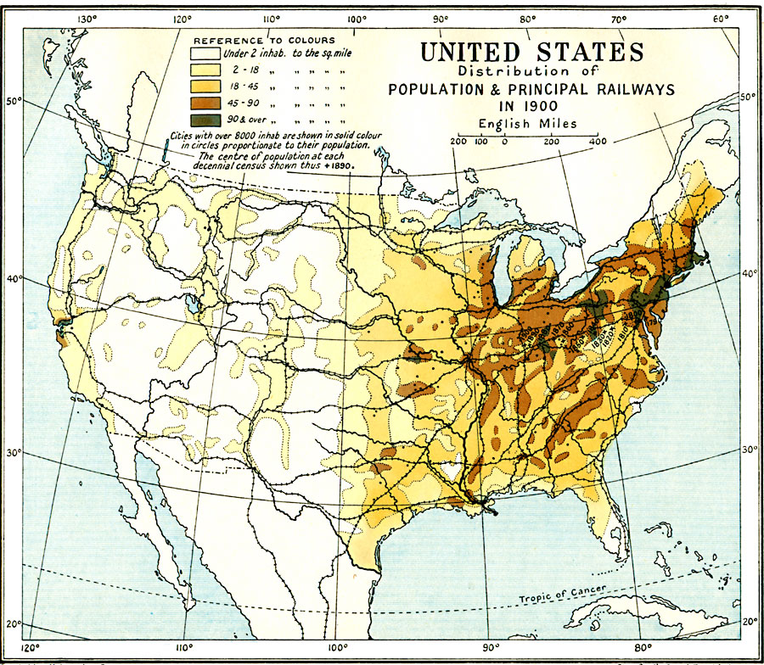

Slide 7
Why do railroads matter?
What purpose do railroads serve?
They facilitate the movement of goods and people
What does having more railroads enable you to do?
People can migrate in greater numbers
Producers can reach new markets
Far-flung towns can consume goods from far away
Who benefits from expanding rail networks?
Producers of goods
People who work for railroad companies
Migrants

Slide 8
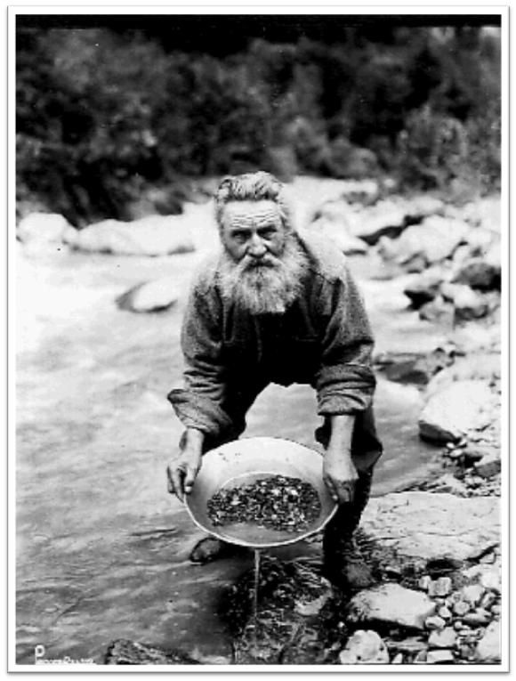
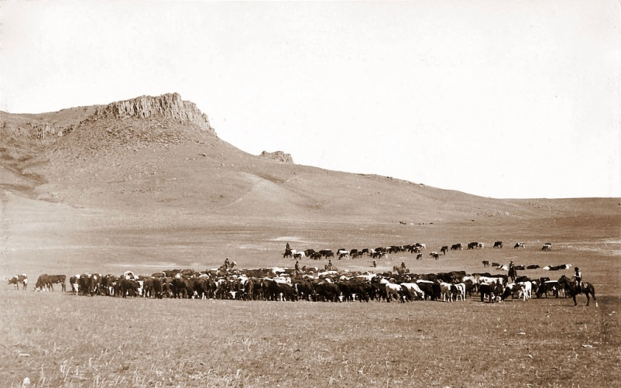
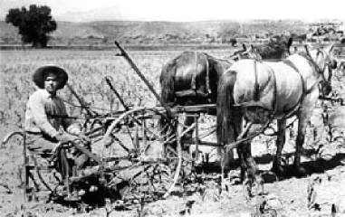
So who migrated westward?
Prospectors (miners) looking for gold
Ranchers raising cattle
Farmers growing crops (mostly wheat)
Merchants

Slide 9
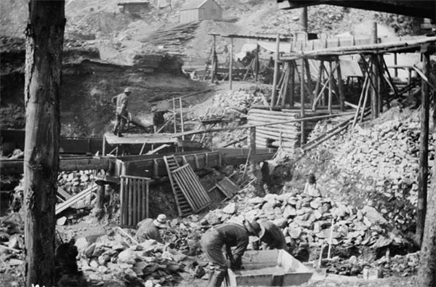
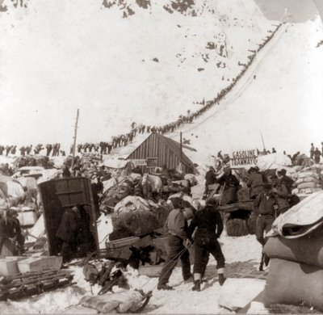
Klondike Gold Rush (1896-1899)
About 100,000 people attempted to reach the Klondike region to exploit its gold
Only 30,000 made it to the region
Only 4,000 actually found any gold

Slide 10
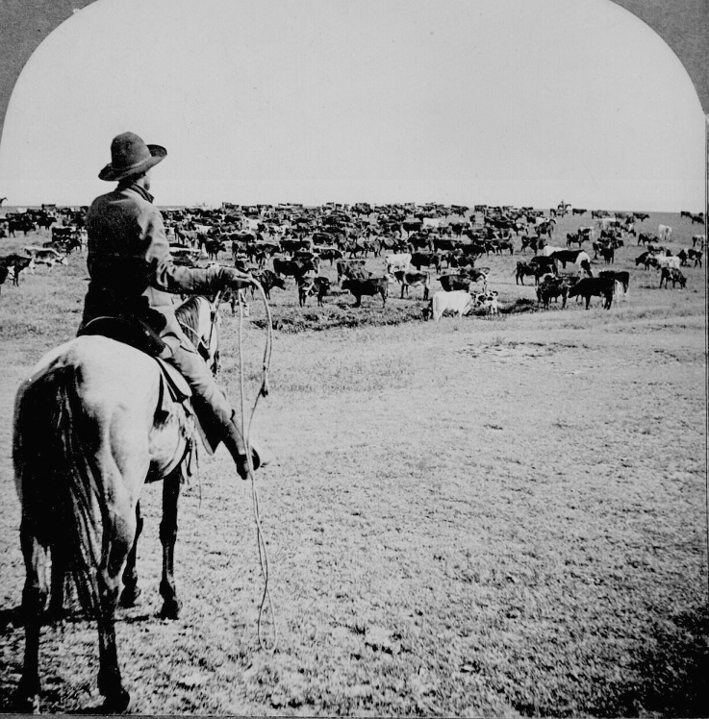
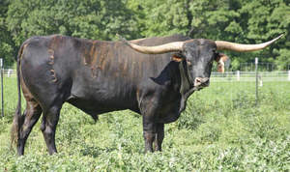
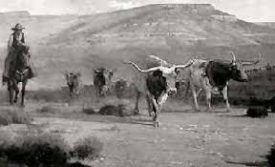
Ranchers
Did not raise cattle on the Great Plains in the early 1800s because…
There was not enough water for the cattle
Railroads were not expansive enough to make transportation to eastern markets easy
The Texas Longhorn could survive on the Great Plains, opened up the west to ranchers

Slide 11
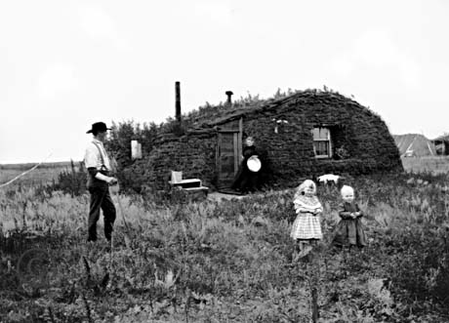
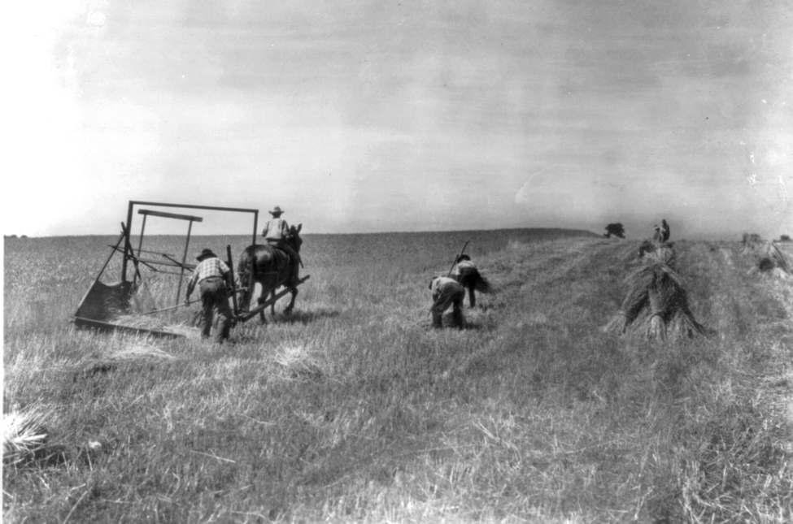
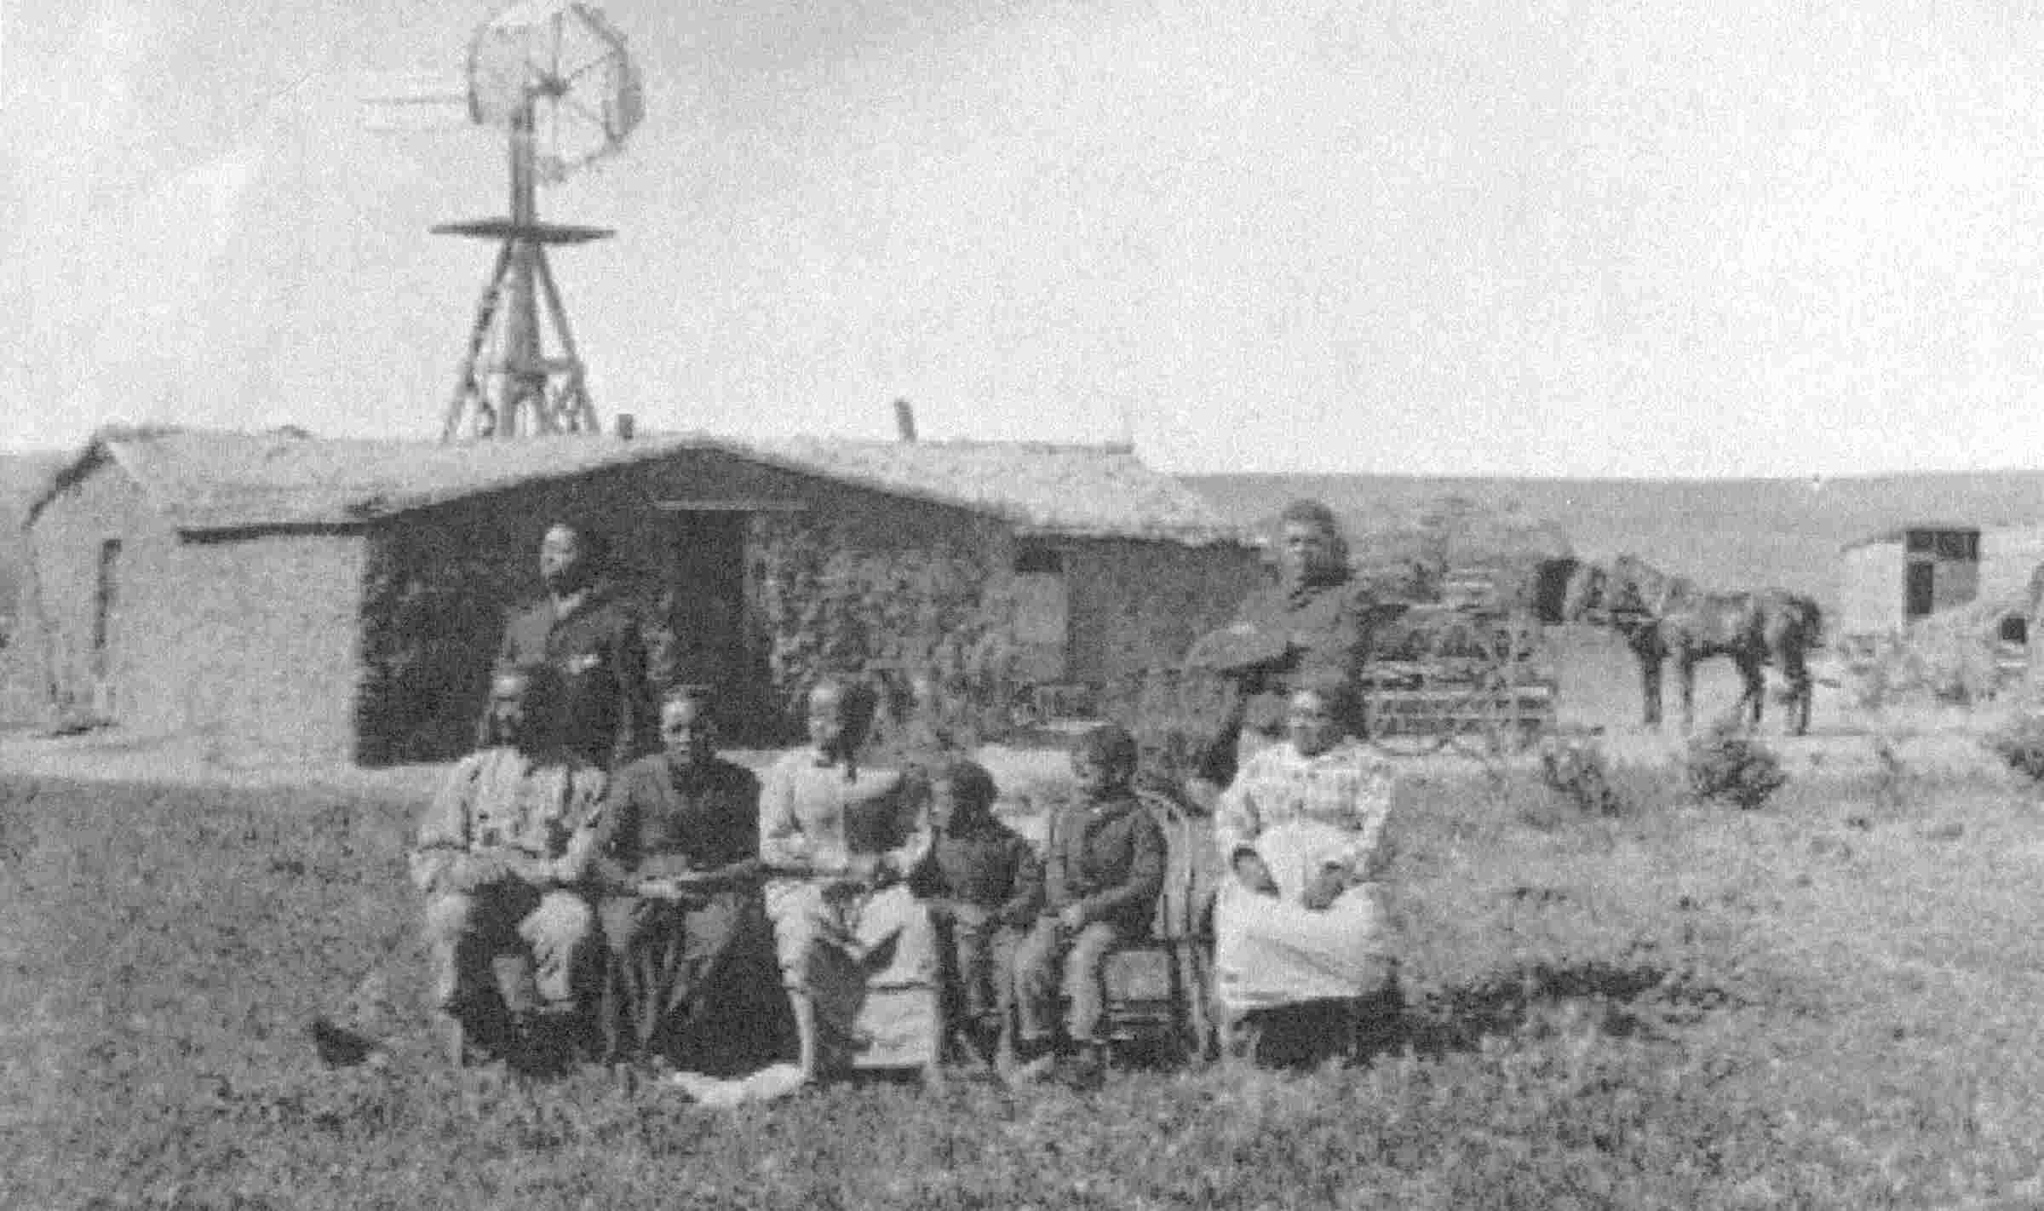
Farmers
Built their own homesteads
Grew wheat using a technique called “dry farming” which did not require much water (no irrigation necessary)
Risked losing everything to drought
Used railroads to ship their harvest to eastern markets

Slide 12
Big picture
The discovery of valuable minerals in the west
+
The boost in food production (beef, wheat, etc.) in the west which could be shipped east on trains
=
Mass migration out west to be ranchers or miners or farmers and mass migration to cities to work in factories

Slide 13
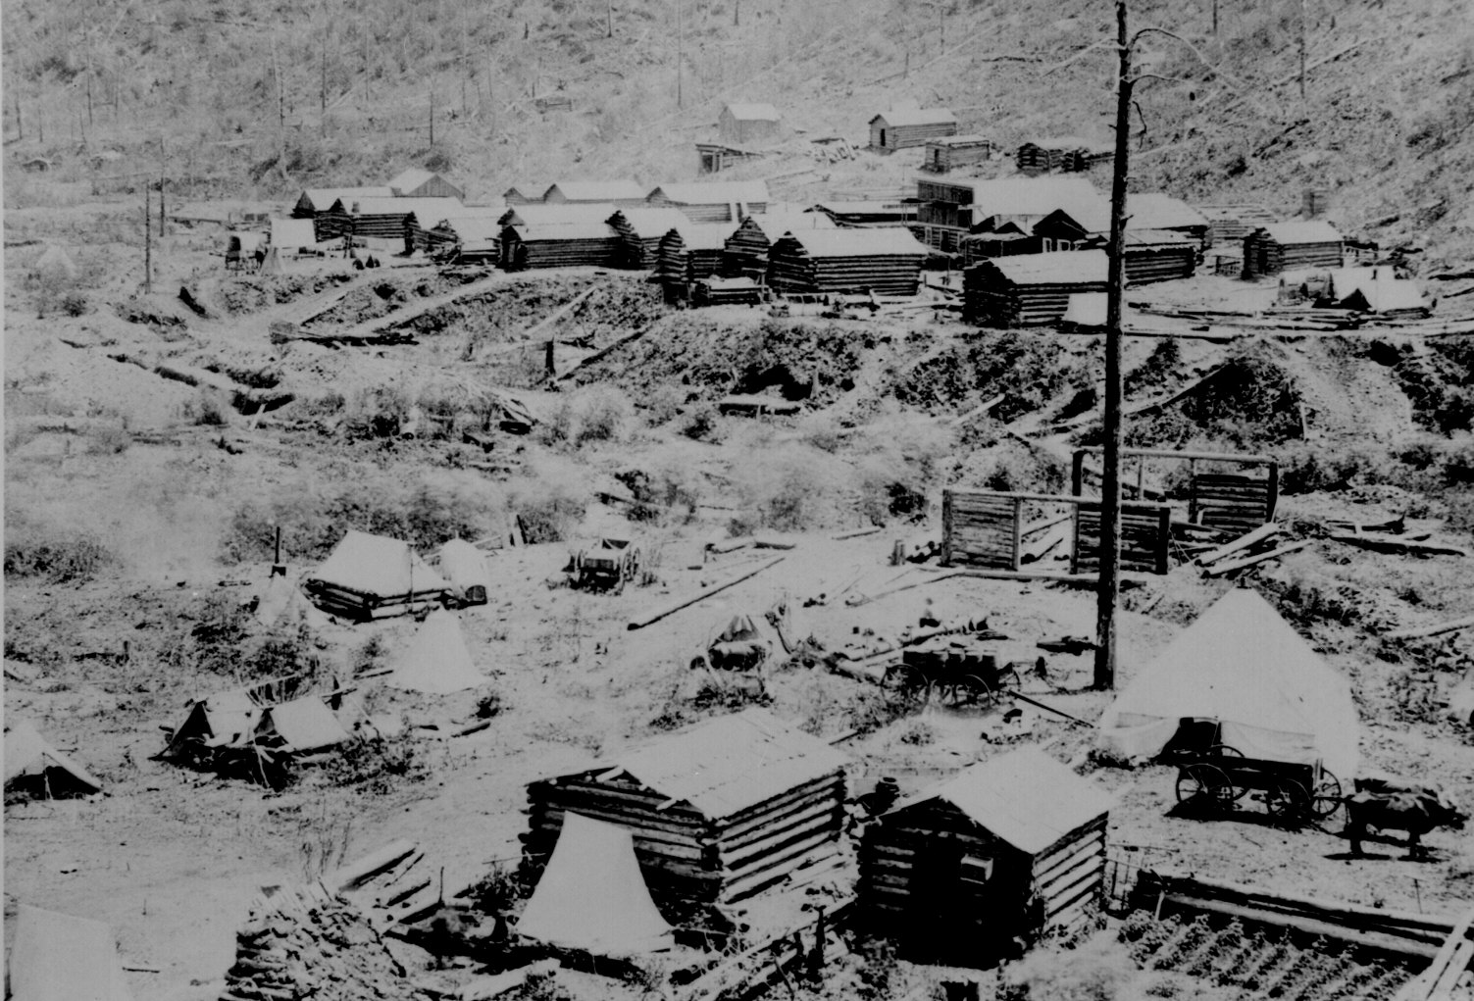
“Boom Towns”
A community which expands very rapidly

